Slide 1
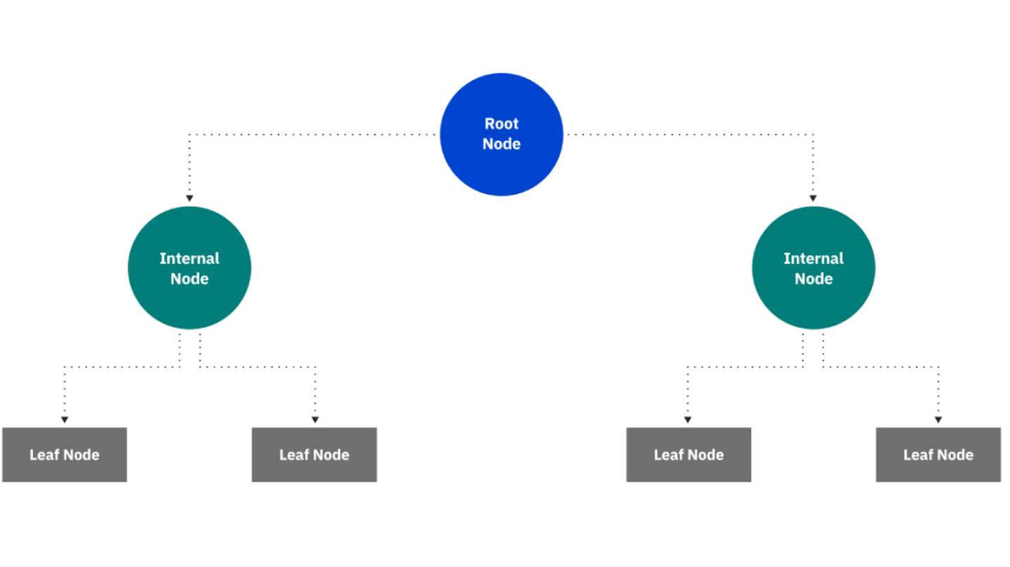
Titanic (Decision-Tree Algorithm)
Minor Assesment Machine Learning Project?
Manish Kumar Singh
DS7B-2206
Big Data Analytics
1. Explain The Decision Tree Algorithm ?
A decision tree is a non-parametric supervised learning algorithm, which is utilized for both classification
and regression tasks. It has a hierarchical, tree structure, which consists of a root node, branches, internal nodes and leaf nodes.
2. Explain Decision Tree Classifier?
Decision tree classifiers are used successfully in many diverse areas. Their most important feature is the capability of capturing descriptive decisionmaking knowledge from the supplied data. Decision tree can be generated from training sets. The procedure for such generation based on the set of objects (S), each belonging to one of the classes C1, C2, …, Ck is as follows
Step 1. | If all the objects in S belong to the same class, for example Ci, the decision tree for S consists of a leaf labelled with this class.
Step 2. | Otherwise, let T be some test with possible outcomes O1, O2,…, On. Each object in S has one outcome for T so the test partitions S into subsets S1, S2,… Sn where each object in Si has outcome Oi for T. T becomes the root of the decision tree and for each outcome Oi we build a subsidiary decision tree by invoking the same procedure recursively on the set Si.

Slide 2
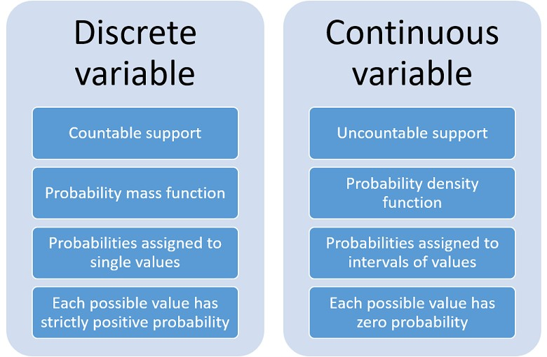
Titanic (Decision-Tree Algorithm)
3. Explain the concept of normally distributed and Continuos Variables?

Slide 3
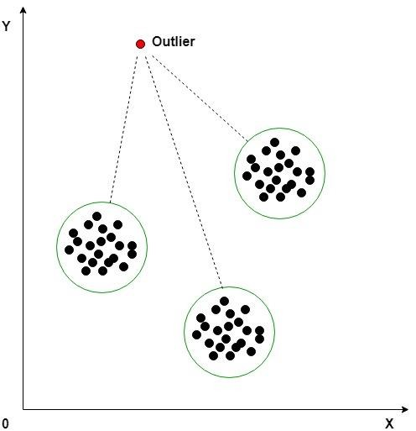
Titanic (Decision-Tree Algorithm)
4. Explain Outliers in ML Project?
An outlier is an object that deviates significantly from the rest of the objects. They can be caused by
measurement or execution error. The analysis of outlier data is referred to as outlier analysis or outlier mining.
Why outlier analysis?
Most data mining methods discard outliers noise or exceptions, however, in some applications such as fraud detection, the rare events can be more interesting than the more regularly occurring one and hence, the outlier analysis becomes important in such case.
Algorithm:
Calculate the mean of each cluster
Initialize the Threshold value
Calculate the distance of the test data from each cluster mean
Find the nearest cluster to the test data
If (Distance > Threshold) then, Outlier
5. Explain the concept of Mode(), Min(), Max()?
Min and max: Shows you the lowest (minimum) and highest (maximum) values in your column.
A mode of a continuous probability distribution is often considered to be any value x at which its probability density function has a local maximum value, so any peak is a mode.

Slide 4
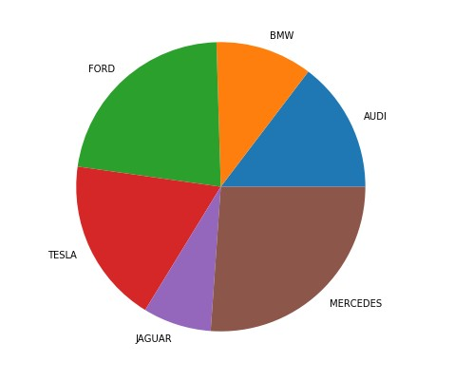
Titanic (Decision-Tree Algorithm)
6. Explain Various type of Plot used in Project
Pieplot
A Pie Chart is a circular statistical plot that can display only one series of data. The area of the chart is the total percentage of the given data. The area of slices of the pie represents the percentage of the parts of the data. The slices of pie are called wedges. The area of the wedge is determined by the length of the arc of the wedge. The area of a wedge represents the relative percentage of that part with respect to whole data.
Creating Pie Chart
Matplotlib API has pie() function in its pyplot module which create a pie chart representing the data in an array.
Syntax: matplotlib.pyplot.pie(data, explode=None, labels=None, colors=None, autopct=None, shadow=False)
Parameters:
data represents the array of data values to be plotted, the fractional area of each slice is represented by data/sum(data). If sum(data)<1, then the data values returns the fractional area directly, thus resulting pie will have empty wedge of size 1-sum(data).
labels is a list of sequence of strings which sets the label of each wedge.
color attribute is used to provide color to the wedges.
autopct is a string used to label the wedge with their numerical value. shadow is used to create shadow of wedge.

Slide 5
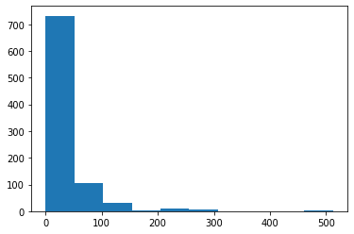
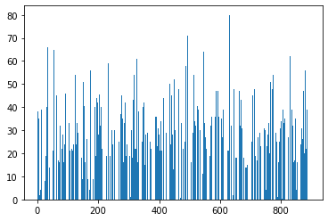
Titanic (Decision-Tree Algorithm)
Histogram
A histogram is basically used to represent data provided in a form of some groups.It is accurate method for the graphical representation of numerical data distribution.It is a type of bar plot where X-axis represents the bin ranges while Y-axis gives information about frequency.
The following table shows the parameters accepted by matplotlib.pyplot.hist() function :
Bar Plot
A bar plot or bar chart is a graph that represents the category of data with rectangular bars with lengths and heights that is proportional to the values which they represent. The bar plots can be plotted horizontally or vertically. A bar chart describes the comparisons between the discrete categories. One of the axis of the plot represents the specific categories being compared, while the other axis represents the measured values corresponding to those categories.
Creating a bar plot
The matplotlib API in Python provides the bar() function which can be used in MATLAB style use or as an object-oriented API. The syntax of the bar() function to be used with the axes is as follows:-
plt.bar(x, height, width, bottom, align)
The function creates a bar plot bounded with a rectangle depending on the given parameters.

Slide 6
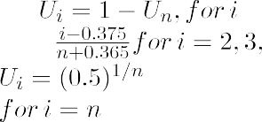
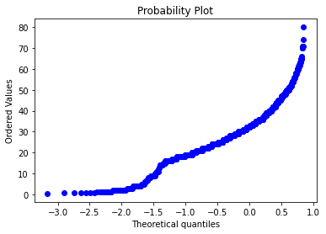
Titanic (Decision-Tree Algorithm)
Probability Plot
Normal Probability plot: The normal probability plot is a way of knowing whether the dataset is normally distributed or not. In this plot, data is plotted against the theoretical normal distribution plot in a way such that if a given dataset is normally distributed it should form an approximate straight line. The normal probability plot is a case of the probability plot (more specifically Q-Q plot). This plot is commonly used in the industry for finding the deviation from the normal process.
The normal probability plot has the following axis.
Horizontal Axis: Normal-order statistic medians.
Vertical Axis: Order response values
The order response variable can be calculated as:
Where Ui is the uniform order median statistics and G is the percent point function of normal distribution. It is the inverse of the cumulative distribution function. i.e given probability distribution, we want the cumulative distribution function.
The uniform order statistics medians can be approximated by:
The underlying assumptions for a measurement process that the data should have following
Random numbers.
From fixed distributions.
With fixed location
With a fixed scale.

